Slide 1
Data Mining in clustering

Slide 2
برای کشف داده‌های پرت در جریان داده، یکی از روش‌های مورد استفاده خوشه‌بندی است. خوشه‌بندی به ما کمک می‌کند تا داده‌ها را به گروه‌های مشابه تقسیم کنیم و داده‌های پرت را از خوشه‌های عادی تشخیص دهیم. یکی از الگوریتم‌های خوشه‌بندی معروف برای کشف داده‌های پرت، الگوریتم DBSCAN است.
DBSCAN (Density-Based Spatial Clustering of Applications with Noise) یک الگوریتم خوشه‌بندی است که بر اساس چگالی داده‌ها عمل می‌کند. این الگوریتم به ما امکان می‌دهد خوشه‌هایی را که دارای چگالی بالا هستند تشخیص دهیم و داده‌های پرت را از خوشه‌های کم چگال جدا کنیم. با استفاده از DBSCAN، می‌توانیم داده‌های پرت را در جریان داده شناسایی کنیم.
در این روش، ابتدا باید پارامترهایی مانند شعاع همسایگی و تعداد حداقل داده‌ها برای تشکیل یک خوشه را تعیین کنیم. سپس الگوریتم DBSCAN را روی داده‌ها اجرا می‌کنیم تا خوشه‌ها و داده‌های پرت را شناسایی کنیم.
استفاده از خوشه‌بندی برای کشف داده‌های پرت در جریان داده می‌تواند در بسیاری از حوزه‌ها مفید باشد، از جمله تحلیل داده‌های حجیم، تشخیص تقلب در تراکنش‌های مالی، تحلیل رفتار کاربران در شبکه‌های اجتماعی و غیره.
منابع:
' ...'
'A Conceptual Framework for Preprocessing and Improving Quality ...'

Slide 3
https://science.ut.ac.ir/documents/84413665/110319729/kord-asabi.pdf
عملکرد الگوریتم Stream-EAC F با مجموعه اي از آزمایش هایی که هم از داده هاي ترکیبی و هم از جریان هاي داده ي استفاده می کنند نشان داده می شود و الگوریتم را با چهار الگوریتم مرتبط به نام هاي OMRk+- + StreamKM، BkM-CluStream، OMRk-CluStream و BkM+- + StreamKM مقایسه می کنیم.
https://www.iwrr.ir/article_87950.html
https://www.sid.ir/paper/159026/fa
https://smartinsight.ir/%D8%B1%D9%88%D8%B4-%D9%87%D8%A7%DB%8C-%D8%AF%D8%A7%D8%AF%D9%87-%DA%A9%D8%A7%D9%88%DB%8C/

Slide 4
Feeling lost in OS, DBMS, CN, SQL, and DSA chaos?
https://www.geeksforgeeks.org/clustering-in-data-mining/#
https://www.geeksforgeeks.org/data-mining-cluster-analysis/

Slide 5
Start

Slide 6
Introduce
Data stream is a potentially massive, continuous, rapid sequence of data information. It has aroused great concern and research upsurge in the field of data mining
Clustering is an effective tool of data mining, so data stream clustering will undoubtedly become the focus of the study in data stream mining

Slide 7
Why?
In view of the characteristic of the high dimension, dynamic, real-time, many effective data stream clustering algorithms have been proposed
In addition, data stream information are not deterministic and always exist outliers and contain noises, so developing effective data stream clustering algorithm is crucial

Slide 8
Where?
weather forecast information
monitoring information for network media transmission
sensor transfer information in coal mines
access to website information
economic information produced by finance and securities companies
agricultural, engineering control and so on
Because of this form of data is massive and updated in real time, traditional clustering methods cannot be used to process it

Slide 9
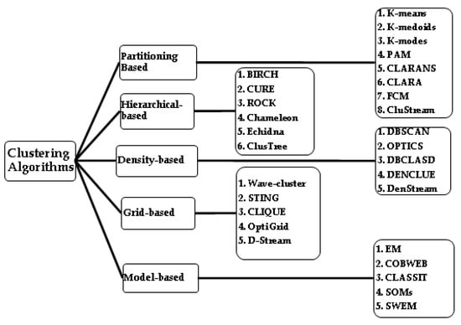
Overall

Slide 10
Traditional Methods
Hierarchical Clustering
Agglomerative
Divisive
Partitioning Clustering
K-Means
K-Medoids
CLARANS
Density-Based Clustering
DBSCAN
OPTICS
Model-Based Clustering
EM (Expectation-Maximization)

Slide 11
Hierarchical
Pros:
No need to specify clusters beforehand: Forms a hierarchy of clusters without needing the number of clusters predefined.
Interpretability: Provides a dendrogram to visualize cluster relationships.
Cons:
Computationally expensive: Can be slow and memory-intensive for large datasets.
Difficulty handling large datasets: Not scalable for very large datasets.

Slide 12
Partitioning
Pros:
Simple and easy to implement: Especially K-Means.
Efficient for large datasets: Works well with a large number of variables.
Cons:
Sensitive to initial points: Results can vary based on the initial selection of centroids.
Assumes spherical clusters: Not suitable for non-spherical or irregularly shaped clusters.

Slide 13
Density-Based
Pros:
Robust to outliers: Can identify outliers as noise points.
Handles arbitrary-shaped clusters: Not limited to spherical clusters.
Cons:
Parameter-sensitive: Requires setting parameters like epsilon and minPoints, which can impact results.
Difficulty with varying densities: Struggles when clusters have significantly different densities.

Slide 14
Model-Based
Pros:
Probabilistic clustering: Provides a probabilistic framework for cluster assignment.
Accommodates mixed distributions: Suitable for data with complex structures.
Cons:
Assumes a specific distribution: Might not perform well if the assumed distribution doesn't match the data.
Sensitive to model assumptions: Performance heavily relies on the correctness of the assumed model.

Slide 15
MATLAB Categories
Hierarchical Clustering
k-Means and k-Medoids Clustering
Density-Based Spatial Clustering of Applications with Noise (DBSCAN)
Gaussian Mixture Model
k-Nearest Neighbor Search and Radius Search
Spectral Clustering

Slide 16
Which method?
Data Characteristics: Density-based methods like DBSCAN suit datasets with varying cluster densities.
Cluster Shape: For non-spherical clusters, density-based or hierarchical methods might be better.
Scalability: Partitioning methods like K-Means are more scalable for larger datasets.
Interpretability: Hierarchical clustering provides an insightful dendrogram.

Slide 17
DataStream vs TraditionalData
Compared with traditional data forms, data stream has its own characteristics.
Traditional data
static and stable
accessed at any time
processed more than once
Data stream
dynamic and it flows like a stream (sequential and changes over time)
Real-time , continuous , ordered (large amount of data , potentially unlimited , arrival rate uncertain)

Slide 18
Typical Stream Data mining Algorithms
Birch
Local Search
STREAM
CluStream

Slide 19
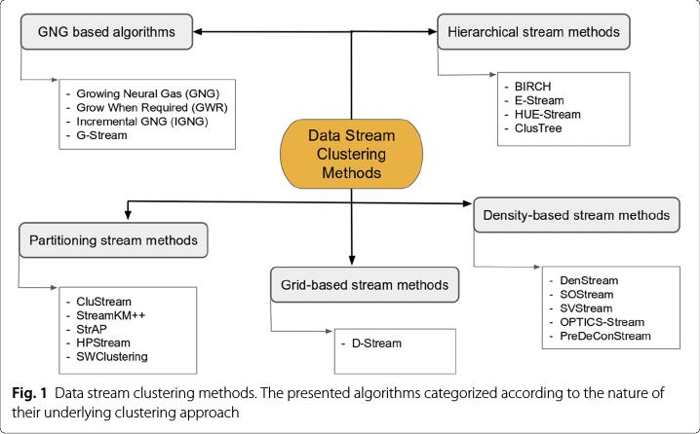
https://cs.stackexchange.com/questions/79429/what-is-the-best-stream-data-clustering-algorithm-that-can-handle-non-static-un

Slide 20
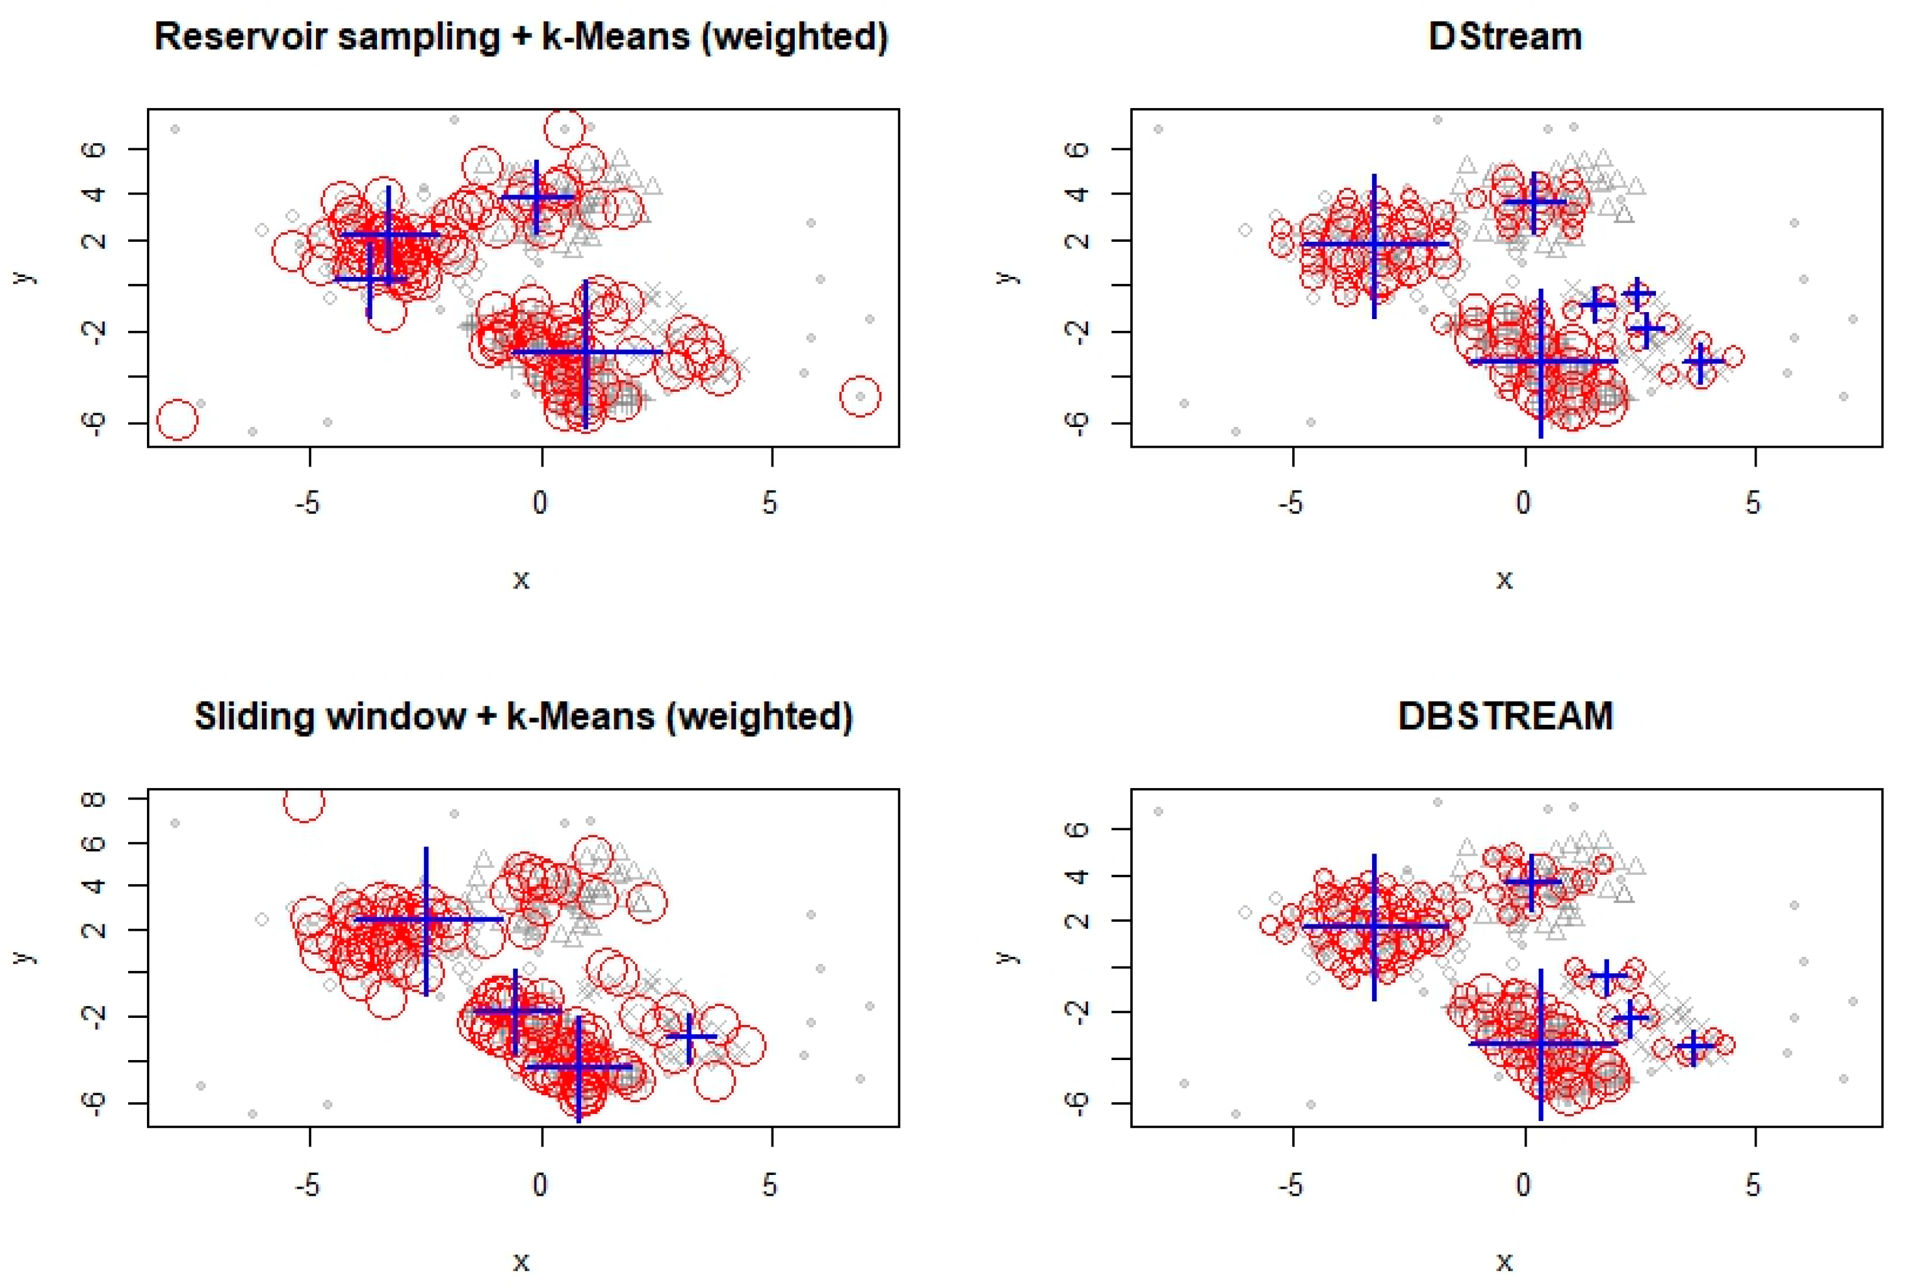
different data stream clustering algorithms
https://www.mdpi.com/2504-2289/2/4/32

Slide 21
Many valid data stream clustering algorithms have been proposed and the experimental results are quite satisfactory:
https://dl.acm.org/doi/10.1145/1557019.1557041
https://dl.acm.org/action/downloadSupplement?doi=10.1145%2F1557019.1557041&file=p139-bifet_nemeds_01.mp4

Slide 22
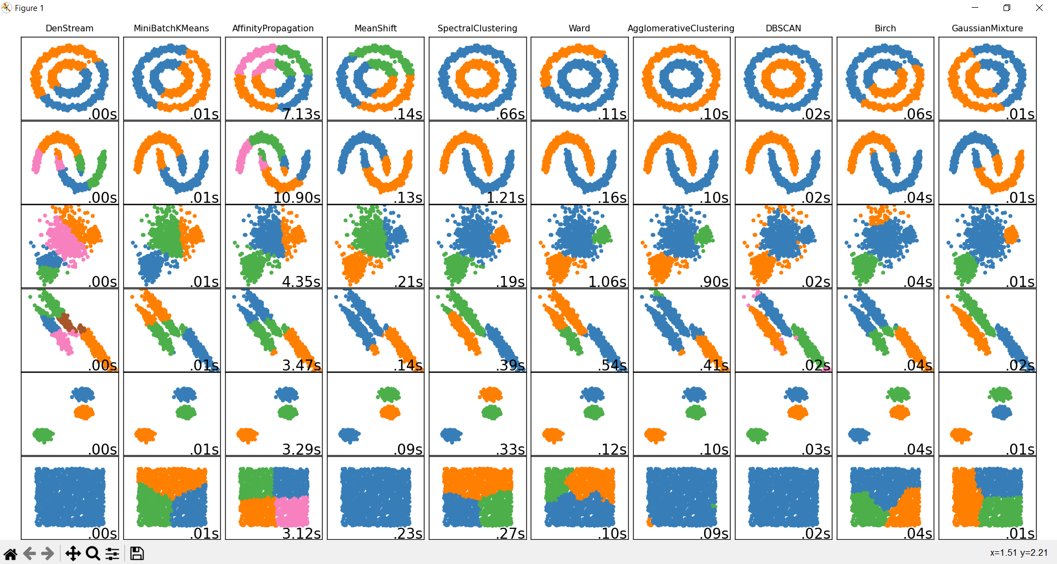
Comparing DenStream

Slide 23
LAST PAGES
summarize the latest research achievements in this field and introduce some new strategies to deal with outliers and noise data

Slide 24
Future
focal points and difficulties of future research for data stream clustering:

Slide 25
Refrences
https://www.sciencedirect.com/science/article/abs/pii/S0167739X19312786
https://www.researchgate.net/figure/Overview-of-the-proposed-two-step-clustering-method-The-first-step-uses-Birch-clustering_fig4_357972949https://www.oreilly.com/library/view/data-mining-and/9781118868706/9781118868706c21.xhtml
https://scikit-learn.org/stable/modules/generated/sklearn.cluster.Birch.html
https://www.geeksforgeeks.org/ml-birch-clustering/
https://en.wikipedia.org/wiki/Data_stream_clustering
https://medium.com/@noel.cs21/balanced-iterative-reducing-and-clustering-using-heirachies-birch-5680adffaa58https://www.youtube.com/watch?v=YWcDgX_pN-8
https://www.youtube.com/watch?v=A4MzbYc4yCY
https://www.sciencedirect.com/science/article/abs/pii/S0167739X19312786
https://doi.org/10.1016/j.future.2020.01.017
https://www.logsign.com/blog/data-stream-clustering-methods-examples
https://arxiv.org/abs/2210.08212
https://github.com/dple/awesome-papers-and-source-code-for-anomaly-detection

